Slide 1

























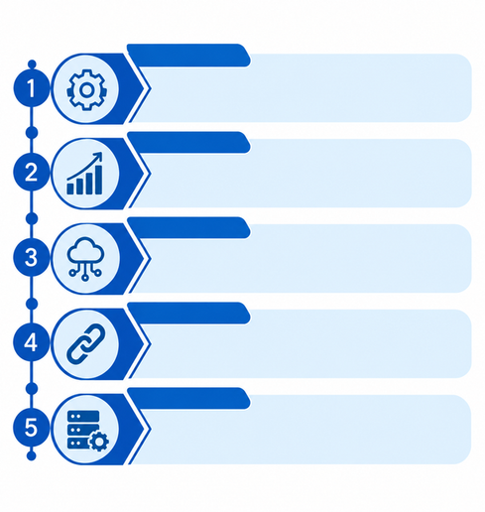



Legacy Coderz
IMPACT AND BENEFITS
POTENTIAL IMPACT
01
02
03
04
05
AICTE Regulation Bureau & Regional Offices
• Sovereign real-time command console over ₹400+ Cr statutory reserves with live 12-month maturity ladders.
• Automated Hard Release Gate eliminates premature discharge liability and paper-file routing leakage.
Operational Velocity
Boost
Regulatory Vigilance
Boost
Zero Release Leakage
Maturity & Triage
Intelligence
Cryptographic Trust
POTENTIAL BENEFITS
96.6% Faster Verification (1.5 Days). Automated CBS query and SFMS MT760 messaging replace 45-day postal turnaround delays.
100% Deterministic Intercept. 8-rule compliance engine catches IFSC mismatches, temporal date inversions, and counterfeit certificates at intake.
Hard Release Gate Defense. Strictly halts premature corpus release and encashment across ₹400+ Cr deposits until all statutory compliances clear.
1,120 Person-Hours Saved. 12-month visual maturity ladder and transparent 100-pt Attention Scoring replace manual ledger tracking.
Immutable SHA-256 Ledger. Tamper-evident cryptographic audit chain and masked views fully compliant with GFR 2017 & DPDP Act 2023.
Technical Institutions, Colleges & Trusts
• 100% digital self-service desk with 10-year renewal wizard, ending postal lost certificates.
• Transparent real-time refund status tracking without physical regional office visits or delays.
Government & Regulatory Impact
Scheduled Commercial & Public Sector Banks
Eliminates Counterfeit Instruments: Directly resolves regulatory risks of forged deposit receipts and duplicate multi-pledging across institutions via instant dual-source CBS provenance matching.
OPEN-SOURCE — Zero Licensing
• Standardized digital verification via SFMS MT760/767 protocols and automated CBS lookup.
• Eliminates manual branch clerical burden of responding to physical inquiry and lien letters.
GOV ALIGNED — APH 2024 & GFR 2017
Pan-India Liquidity & Maturity Ladder: Synthesizes multi-regional collegiate deposits into a sovereign command terminal, alerting officers at 90/60/30/15/7 days before statutory lock-in expires.
100% BILINGUAL — Hindi & English
Guaranteed Student Corpus Protection: Safeguards ₹400+ Cr in educational security deposits, preventing unauthorized pre-closure and enforcing infrastructure compliance before release.
DUAL-SOURCE — Declared vs CBS Bank
Statutory Auditors, Students & Public Interest
• Immutable SHA-256 cryptographic chain of custody guaranteeing zero tampered financial records.
• DPDP Act 2023 compliant privacy views; protected institutional corpus safeguards student education.
National Regulatory Impact | ₹400+ Cr Statutory Corpus Protected | 96.6% Faster Verification | Zero Premature Release Leakage
AUDIT-READY — SHA-256 Hash Chain
AICTE governs thousands of technical institutions, yet physical deposit verification caused 45-day lags and counterfeit exposure. SIH26265 establishes a sovereign terminal ensuring 100% verified, tamper-evident regulatory compliance.
@SIH Idea submission- Template
5

